Slide 1

Approach for Digital Financial Service in Africa
ITU Consumer Forum 2019
Kingdom of eSwatini
31 July 2019
Prepared by: R. Lekhanya

Slide 2
Index
Legal context
Areas of co-operation
The Rails
Recommendations

Slide 3
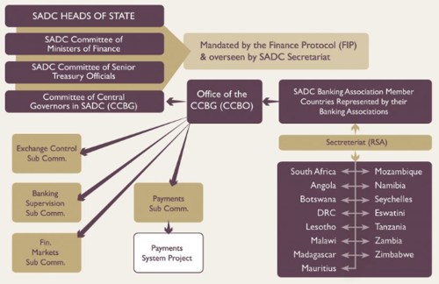
Legal context
Guiding principles shaping engagements for the better in recent days
(STP; Customer-Level vs Transaction-Level Sanctions Screening; etc)

Slide 4
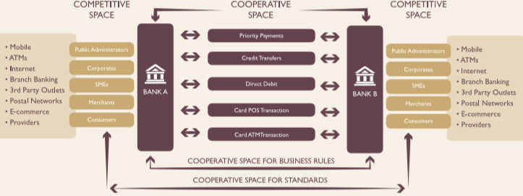
Cooperative vs Competitive space
Digital just another channel?
Notes:
Riyaadah (Riyad) in Session 1 & Ozzie in session 3 indicated that Digital / “Mobile” is not new to Banks
Mbingo from Session

Slide 5
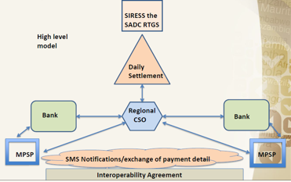
The Rails
SADC RTGS live Jul 13
RCSO role open to competition
Current RSCO messaging in ISO20022 standard
Batch & Real Time (TCIB) - specs being aligned
Settlement Risk being addressed
Advise of Debit
Advise of Credit
New, all-encompassing Association “formed”
Ownership of “current” RCSO up for discussion

Slide 6
Recommendations
Constant, progressive dialog amongst all stakeholders, with following “ingredients”:
  Mutual trust & respect (NO power playing) in the co-operative space
  Agile implementation whenever possible (including through Sandboxes / Labs)
Engagement of Regional Stakeholders / Community as early as possible in all initiatives
  Even if initiative is seen as local
    Lots of wisdom Regionally &
    Helps manage potential future Regional implications better
Regular self-assessment of progress towards agreed goal & self-correction when necessary
  Also taking into account new developments / information
Quality of Service & Data Protection standards require urgent attention
  Including on dispute resolution
    Trust at the heart of Financial Services & cannot & should not be compromised
Notes:
Dialog:
Riyaadah (Riyad) from Session 1 indicated that KYC will continue to be a challenge as people get displaced & lose they primary ID means (documents; fixed physical addresses; etc)
Mbingo from Session 1 indicated that, in an attempt to hide their fraudulently acquired funds, what I choose to call “suspects” continually move from the use of once method of payment to another (& even amongst Service providers)
How can these issues be effectively addressed without the Service Providers who experience these challenges constantly engaging with the FICs / FIUs?
- Agile: Beverly from CBE in session 3 indicated that CBE have publicly committed to Agility

Slide 7
Thank you

